Slide 1

Advertisement
Recalling sanity into drug overdose is a call for all

Slide 2


Purpose
Train
Empower
Equip

Slide 3

Ways of Reducing Overdose
Joining the E-Alerts Platform.
Undertaking a mental health first aid course.
Have knowledge about local treatments.
Ensure Ohio’s opiate prescribing limits are observed.
Encourage business owners to attend training on Naloxone/Narcan.

Slide 4
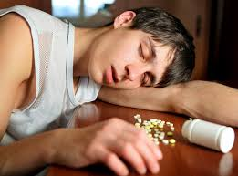
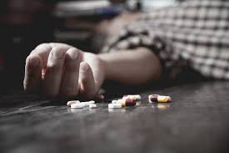
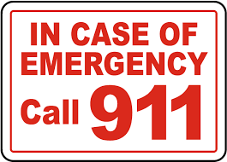
Recommendations for People Using Drugs
Call Samaritan Crisis Care 24/7 at 224-4646 for crisis, treatment and referral.
Have Narcan available, and someone who can administer it, in case of an overdose.
Do not use drugs containing fentanyl.
Do not use drugs alone.
Do not share needles.
In the event of an overdose, call 911 immediately

Slide 5
Graph indicating cases of overdose
Overdose on drugs fro 2017 to 2020

Slide 6

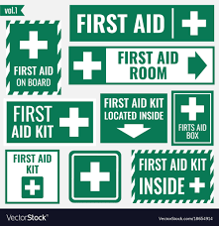

Support
Training will develop skills important for handling emergency.
Empowerment for the drug users to change.
Equipping the society with relevant information.

